Slide 1
Welcome
To
our Presentation

Slide 2

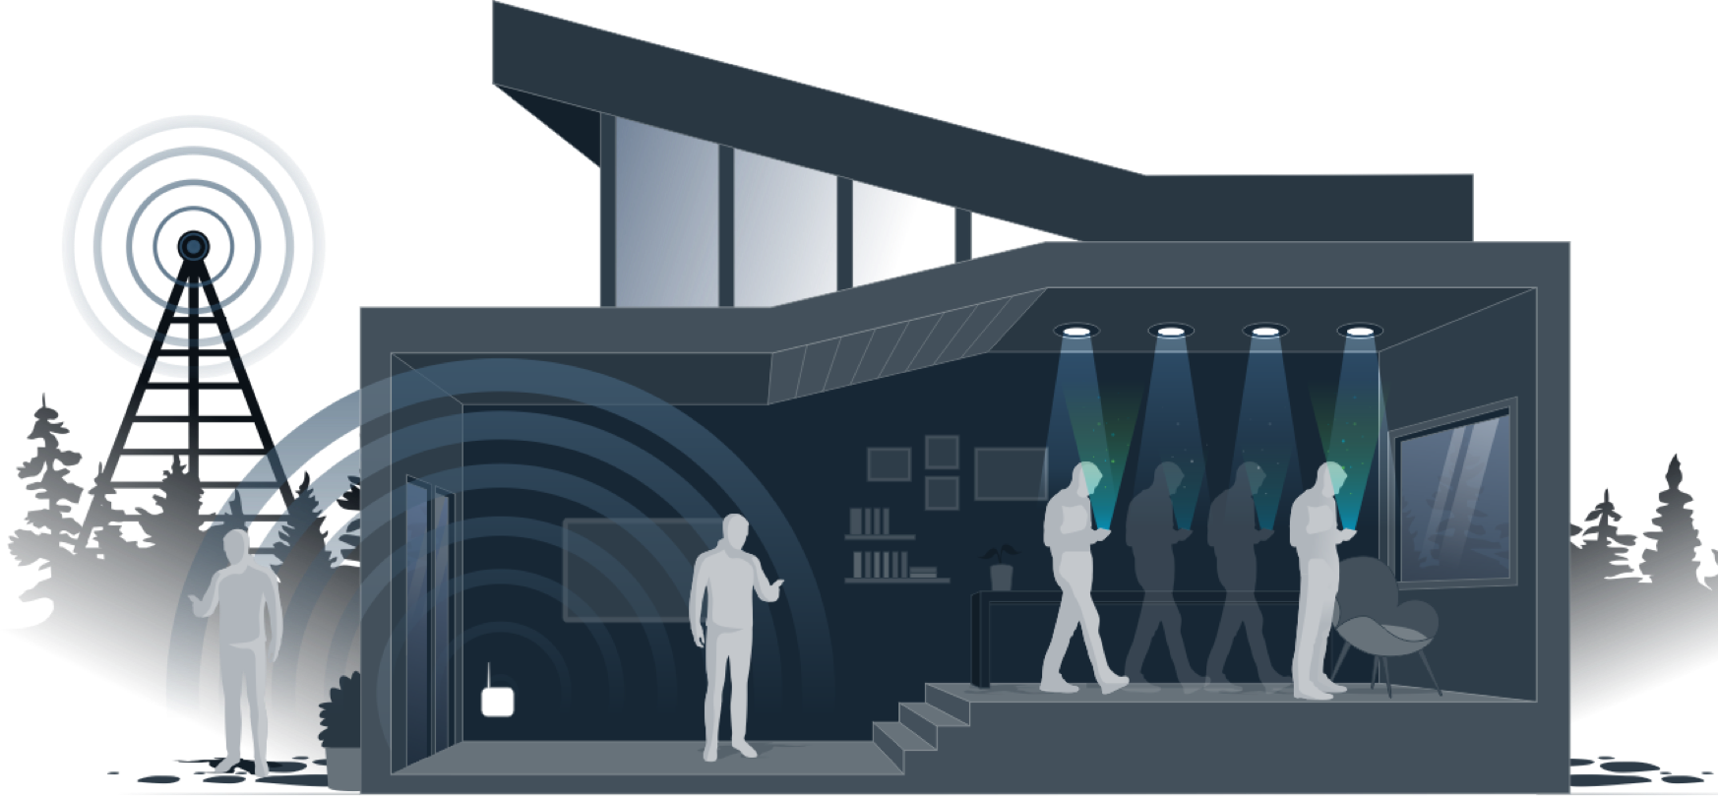
Topic
……………………………………………………..

Slide 3
Team Member
Monisha Biswas
181-15-1928
Noor Afia Shammi
181-15-1994
Sabbir Ahamed
181-15-1928
Md.Yeasin Sheikh
181-15-2049

Slide 4
Intro
Noor Afia Shammi 181-15-1928

Slide 5
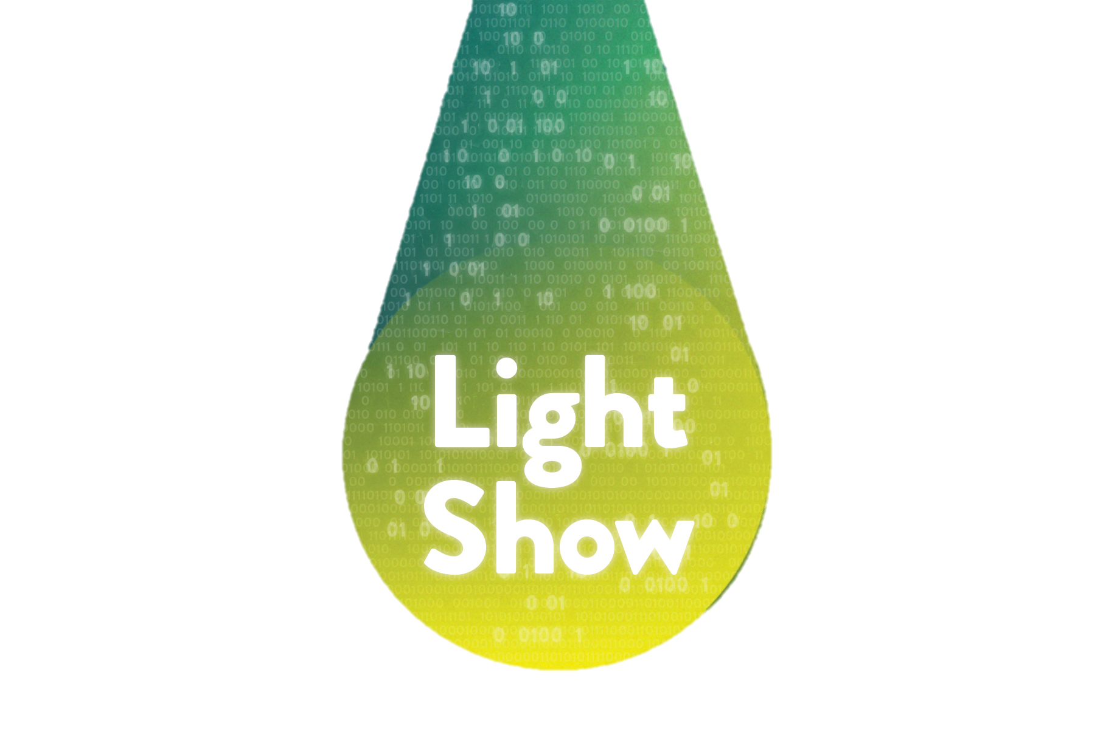
Li-Fi ?
Li-Fi is wireless communication technology, which utilizes light to transmit data and position between devices. The term was first introduced by Harald Haas during a 2011 TED Global talk in Edinburgh.

Slide 6
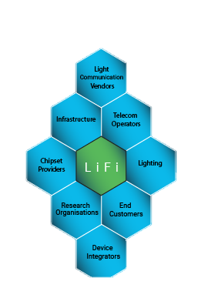
History of Li-Fi ?
Li-Fi was created in 1997 and created by Harald Haas. Li-Fi has shown that it's 100 times faster than Wi-Fi. In October 2011, companies and industry groups formed the Li-Fi consortium, to promote high-speed optical wireless system and to overcome the limited amount of radio-based wireless spectrum available by exploiting a completely different part of the electromagnetic spectrum.

Slide 7

Where Li Fi technology is used?

Slide 8
Implementation
Sabbir Ahmed
181-15-1996

Slide 9

Implementation of Li-Fi
Li-Fi
Emitter
Power Supply
RF Driver
The LI-FI product consists of three primary sub assemblies.

Slide 10
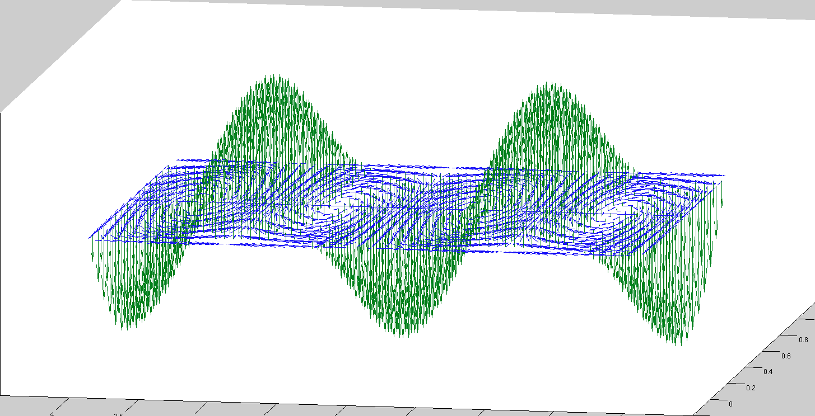
FUNCTION OF BULB ASSEMBLY
At the heart of LI-FI is the bulb sub assembly where a sealed bulb is embedded in a dielectric material
The dielectric material serves two purposes.
1. Wave guide
2. Electric field

Slide 11
RF DRIVER
Power amplifier (PA) assembly that uses an LDMOS device.
Converts electrical energy into RF power.
The PA is designed to ruggedness and efficiency.
The RF driver also contains controls circuit for digital and analog lighting controls.

Slide 12
Issue & process
Monisha Biswas
181-15-1928

Slide 13
Issues regarding radio spectrum?
Radio Spectrum Spectrum is 10,000 times greater than that of radio frequency. Light waves available everywhere.
Highly efficient since LED consumes less energy.
Gama rays, X-rays , Ultraviolet rays are harmful for the human body.
Infrared Rays are also dangerous due to eye safety regulation and can only be used with low power.
Radio waves are expensive and they are less secure.
Therefore, only Visible rays or visible light spectrum is left which is not harmful for humans. Radio Waves Infrared Rays Visible Rays Ultraviolet Rays X-Rays Gamma Rays

Slide 14
Why Li-fi use Visible Light Communication?
Gama rays, X-rays , Ultraviolet rays are harmful for the human body.
Infrared Rays are also dangerous due to eye safety regulation and can only be used with low power.
Radio waves are expensive and they are less secure.
Therefore, only Visible rays or visible light spectrum is left which is not harmful for humans. Radio Waves Infrared Rays Visible Rays Ultraviolet Rays X-Rays Gamma Rays

Slide 15
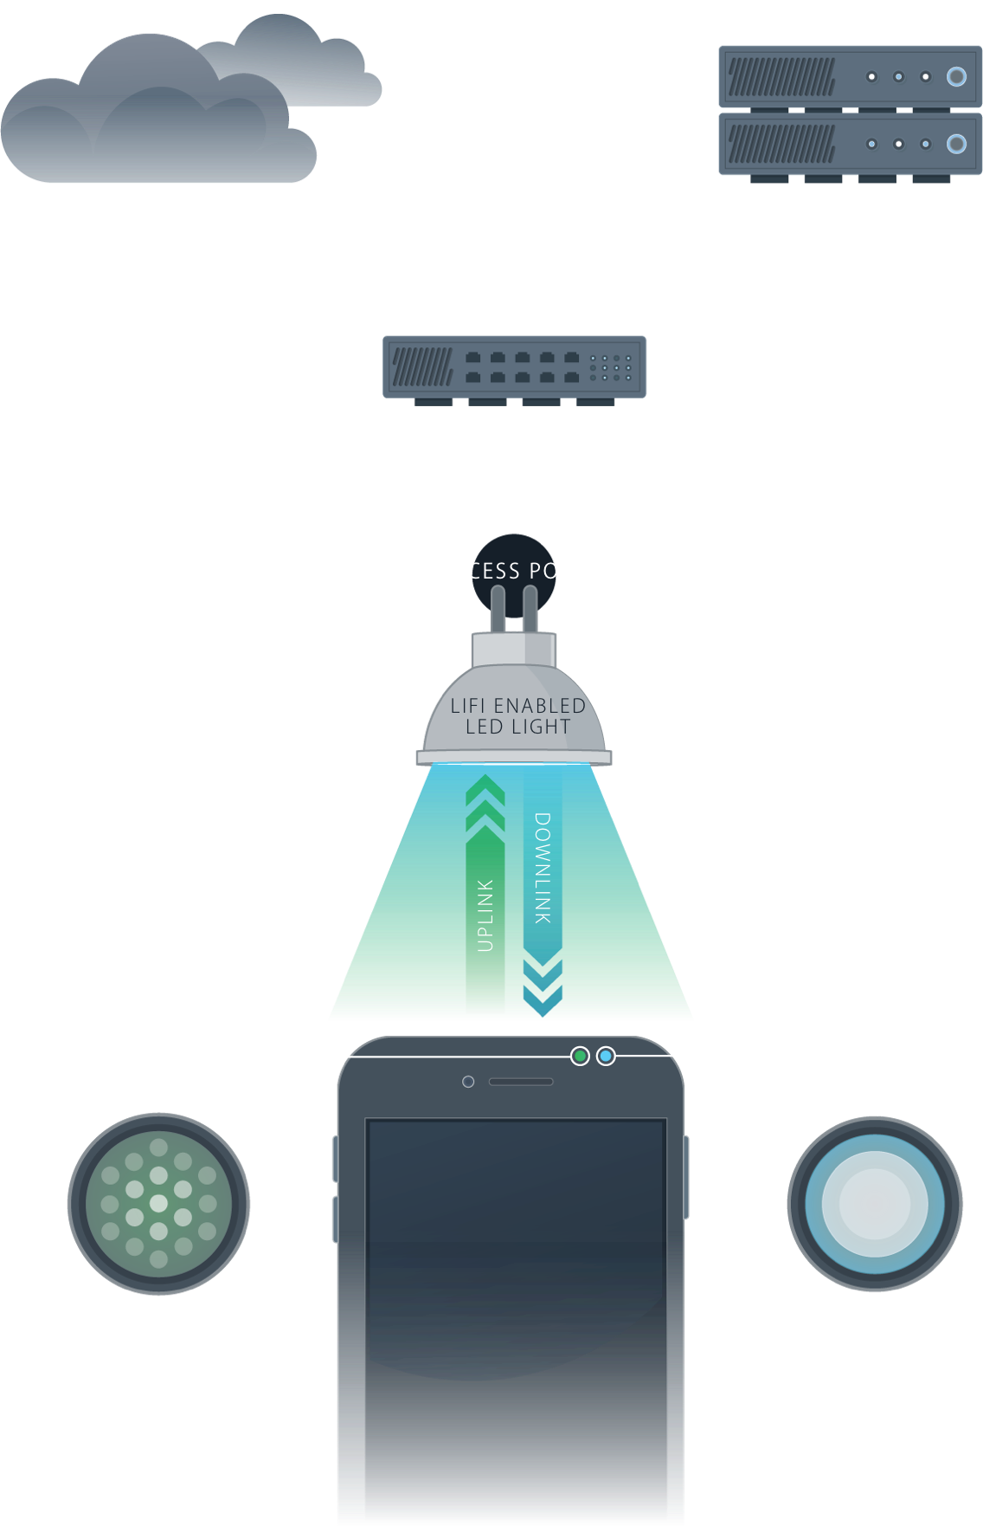
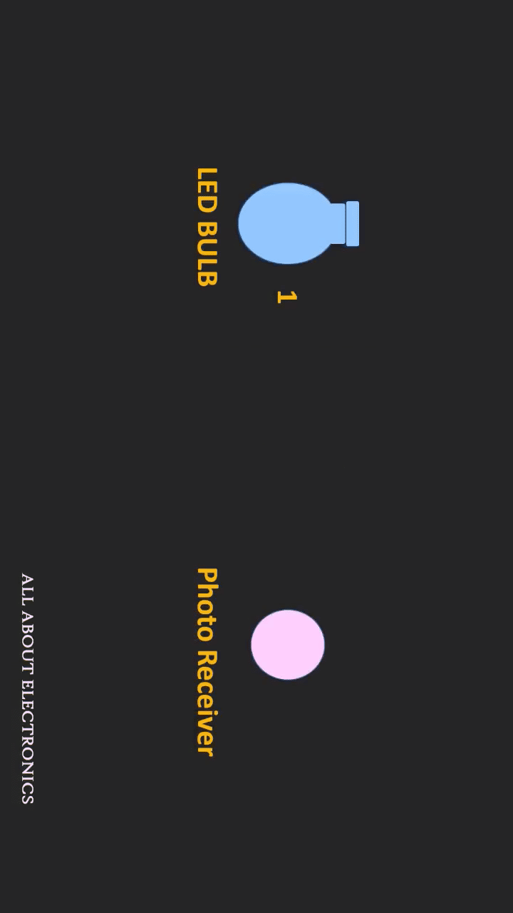
How LI-FI Works?
if the LED is on, you transmit a digit 1, if its off you transmit a digit 0.
Required is some LEDS and a controller that code data into LEDs.
We have to just vary the rate at which the LEDs flicker depending upon the data we want to encode.
Thus every light source will work as a hub for data transmission.

Slide 16
Making the right decision
Md.Yeasin Sheikh
181-15-2049

Slide 17
Where Li-Fi used?
Security
Dense urban environments
Augmented reality
Localized advertising
Underwater communication
Safety environments
Intelligent transportation systems
Connectivity
Sensitive data
Indoor navigation

Slide 18
Pros Compared To Wi-Fi
Li-Fi does not interfere with radio signals.
High internet speeds of Li-Fi over Wi-Fi.
Li-Fi is more secure and offers additional privacy.
It’s harder for neighbors to get on your internet without paying for it.

Slide 19
Cons Compared To Wi-Fi
The coverage distance of Li-Fi is 10 meters while it is 32 meters for a Wi-Fi system.
Li-Fi technology cannot be deployed outdoors in sunlight or in any unstable conditions
LED brightness added to the time we already spend looking at screens isn’t great for our eyes.

Slide 20

Future of Li-Fi
By 2020 …..
80 billion IoT devices 10 times the world population!

Slide 21



😐
Old Dhaka

Slide 22
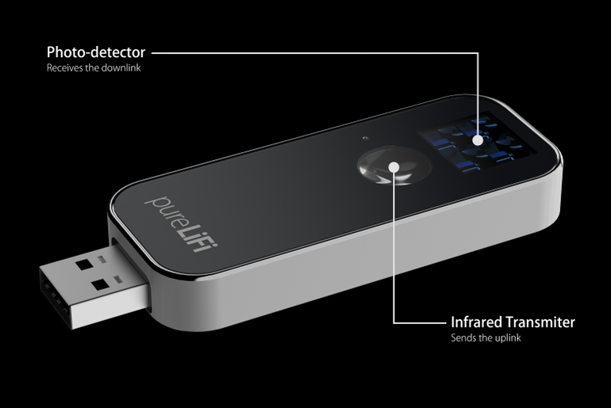

Li-fi Dongle

Slide 23

Li-Fi

